Slide 1
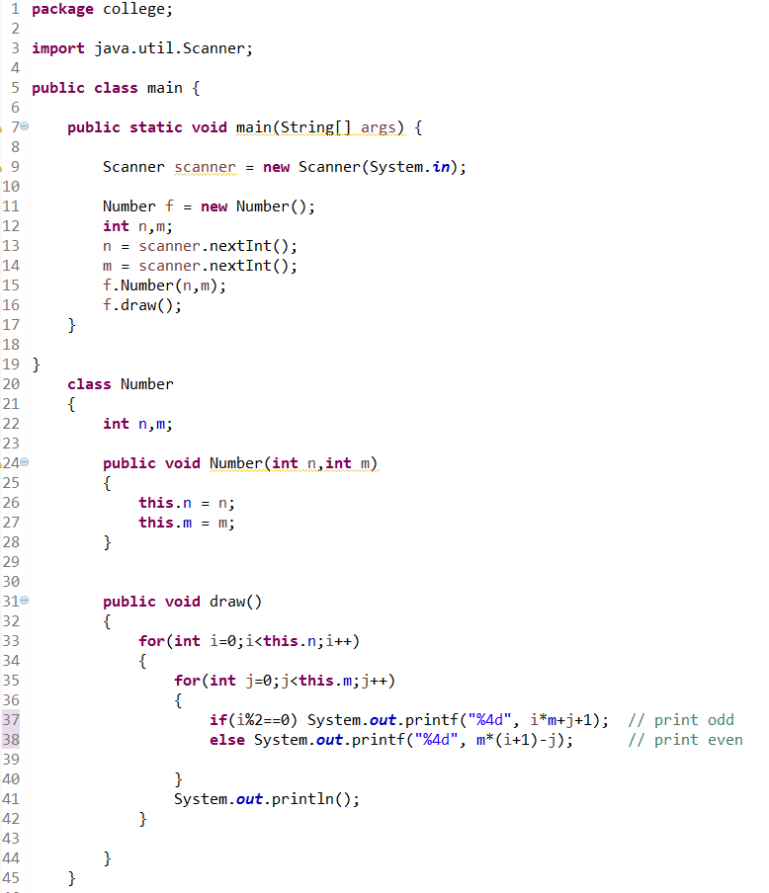
M=5
 | 0 | 1 | 2 | 3 | 4
0 | 1 | 2 | 3 | 4 | 5
1 | 10 | 9 | 8 | 7 | 6
2 | 11 | 12 | 13 | 14 | 15
j
i

